Slide 1
73
Discrete Mathematics
Matrix Representations of Relations and Properties

Slide 2





Slide 3








Slide 4


















Slide 5


Slide 6



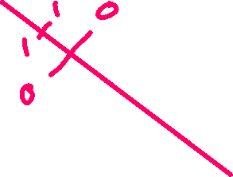



Slide 7

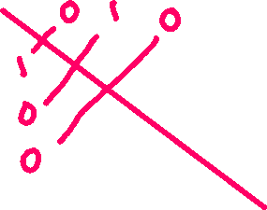






Slide 9

















Slide 11










Slide 12






Slide 13
Up Next…
Representing Relations Using Digraphs

